Slide 1
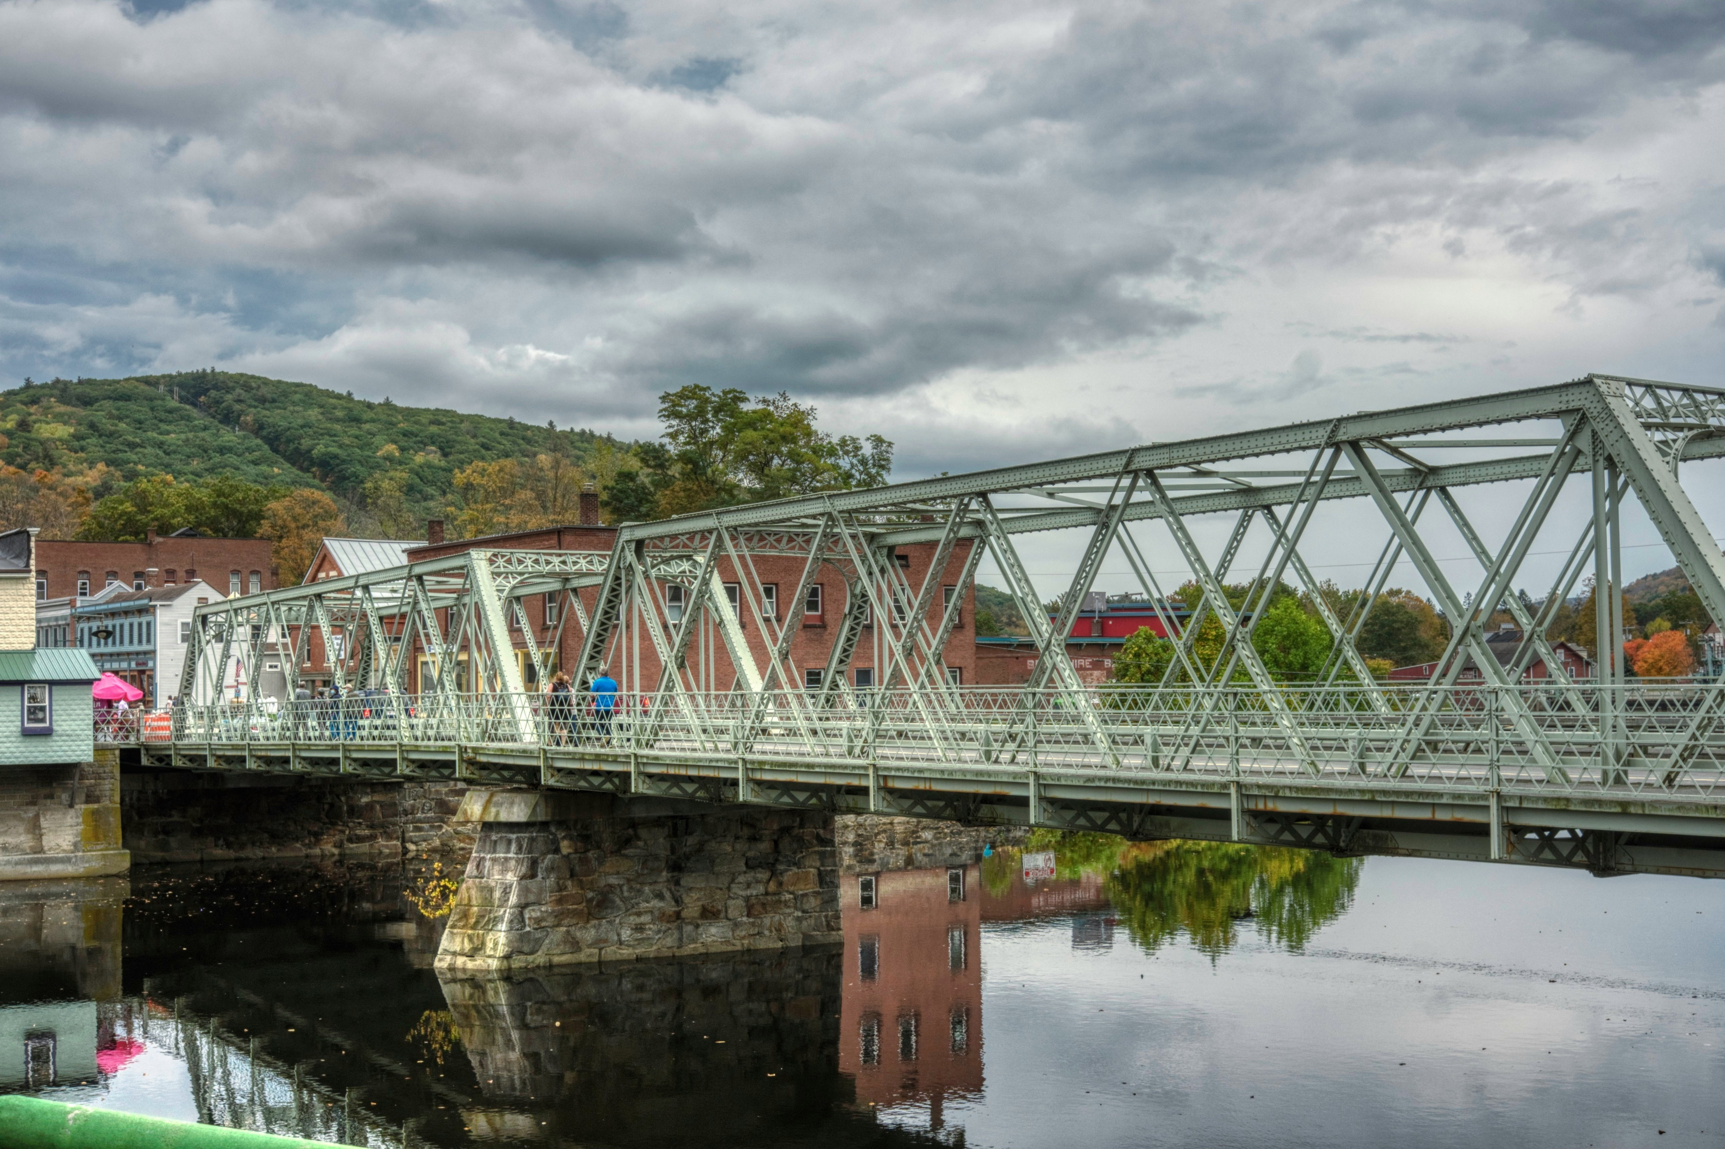
Bayesian Optimisation of a Truss Structure
CEGM2003 DSAIE - TRUSS 1
Niels van Vliet ,Javier Fuertes,Paolo Pantano, Nils Paardekooper, Lourens Nobel

Slide 2
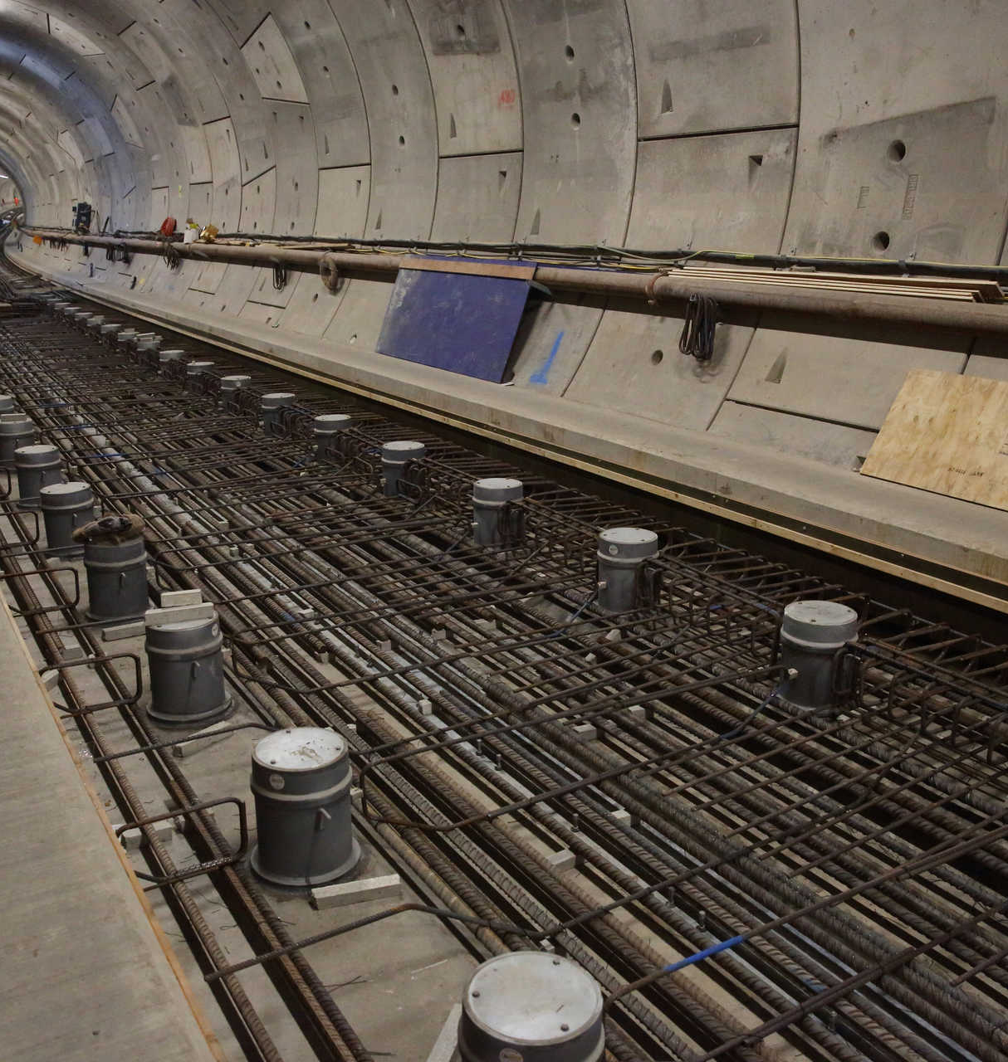
Contents
Introduction into Bayesian Optimisation
Problem Definition
Solution method
Architecture
Dependencies
Results
Benchmarks
Findings
Project objective
The aim of this project is to find an optimal truss design through finding the optimal set of nodal coordinates and cross-sectional properties and solution methods which allow for the most informative and fastest convergence method.

Slide 3
Bayesian optimisation
CEGM2003 DSAI: TRUSS 1

Slide 4
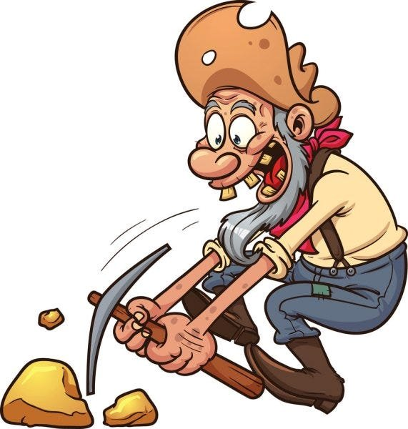
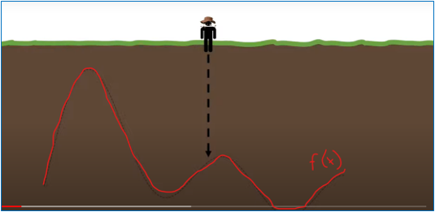
Bayesion optimisation
What is the optimum approach to investigate a space from which we have little to no prior knowledge?
Black Box Function
Confine Search Space
Random Intial Sample
An how do we decide where to sample next?

Slide 5
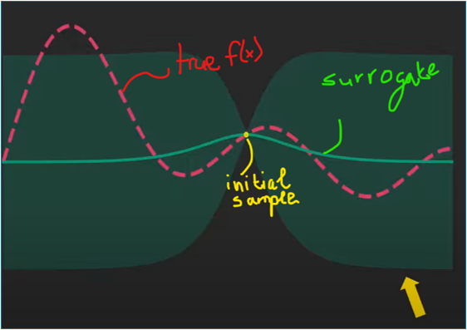
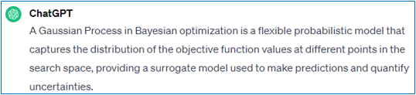
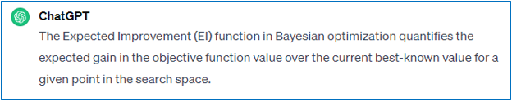
Bayesion optimisation
Surrogate Model - Gaussian Process
Acquisition function – Expected Improvement
High predicitive entropy > exploration​
Low predictive entropy > exploitation

Slide 6
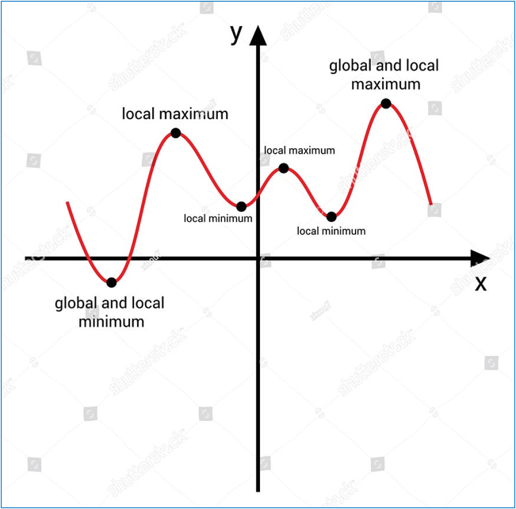
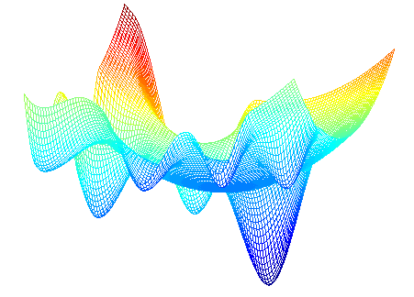
Bayesion optimisation
Exploration vs Eploitation

Slide 7
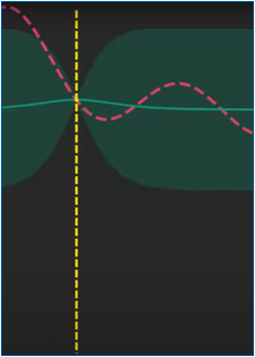
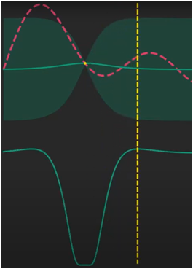
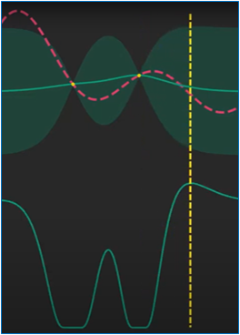
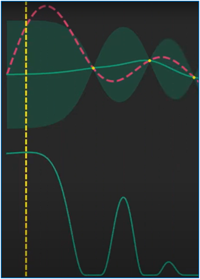
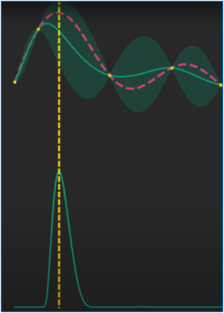
Bayesion optimisation

Slide 8
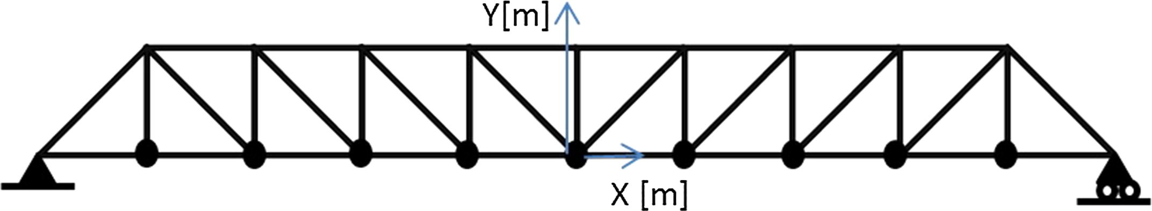
Problem & Approach
y₁
y₂
y₃
y₄
y₅
Curse of Dimensionality
Symmetry
Top nodal coordinates
Cross Sections
Black box model for constraints
PyJive returns the frequencies
Objective function: loss
Minimize total losss
Mass component
Frequency component
Penalty if frequency constraints not met

Slide 9
Our solution approach
CEGM2003 DSAI: TRUSS 1

Slide 10
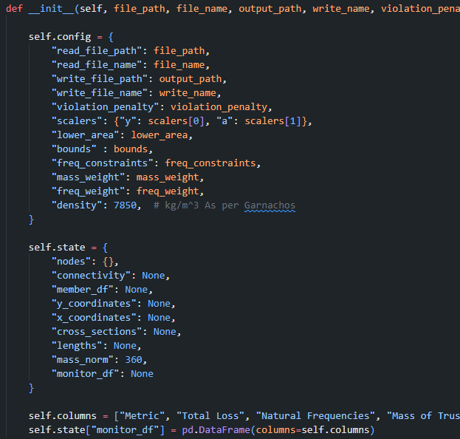
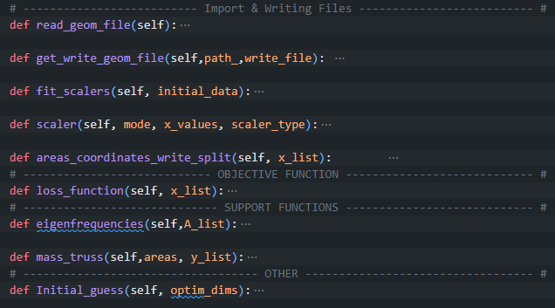
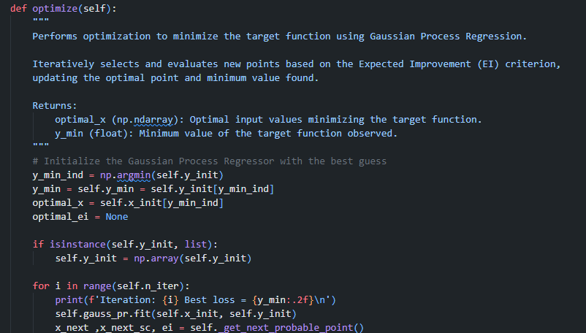
Solution Method Architecture
We begin initiating two classes one for the bridge object and another for the optimiser these will handle the methods specific to their processes.
This involves setting up all paths and files for reading and writing whilst also initiating the different class attributes necessary for the different objective function calculations
We randomly initiate and evaluate our 19 solution space for a given number of times and forward.
At this time we also initially or not, define many of our hyperparameters especially for the gaussian process such as its kernel exploration exploitation tradeoff etc..
Class 1: TRUSS A class whose objective was to store all the atributes and methods neccessary for the processing of the data with pro, geom files and update and store throghout training the progression of itself
Class 2 : BOPT A class solely built to optimise the solution space. It does so through the expl,expl function which includes the acquisition function and random searching.

Slide 11
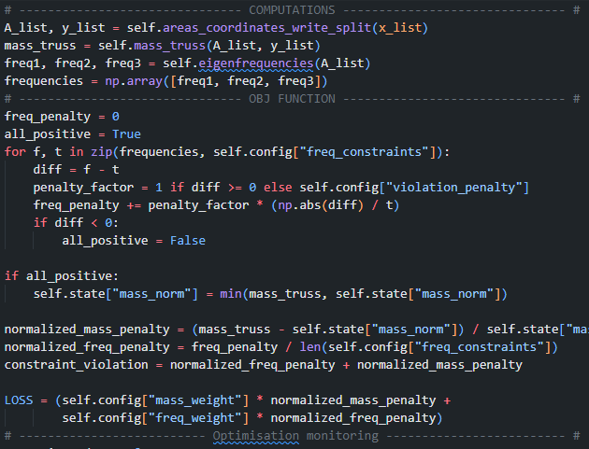
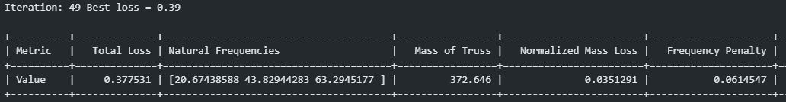
1:
Solution Method Neccessary details 1
Class TRUSS: Objective Function The main components of the objf are, Next solution computations OBJ Function Frequency loss Mass loss Normalisation Weighting Monitoring
2.1:
The objective function is composed of two main parts. Firstly it splits the input vectos and updates the class attributes: cross sections and y coordinates. It later then computes the mass and eigenfrequencies corresponding to the new solution location.
With this we compute the Loss Function:
Frequency loss – Mean absolute difference times a penalty factor. A soft loss penalisation term when frequency constraints are not me.
Mass Loss – A somewhat dynamic constrain. Evaluates mass difference against: from T=0 mass against Karnachos onwards, T=min minimum mass lower than Karnachos that meets the frequency constraints. Through this way we dont discourage the algorithm from keep searching for better methods although..
Weights & Averages
2.2:
3:

Slide 12
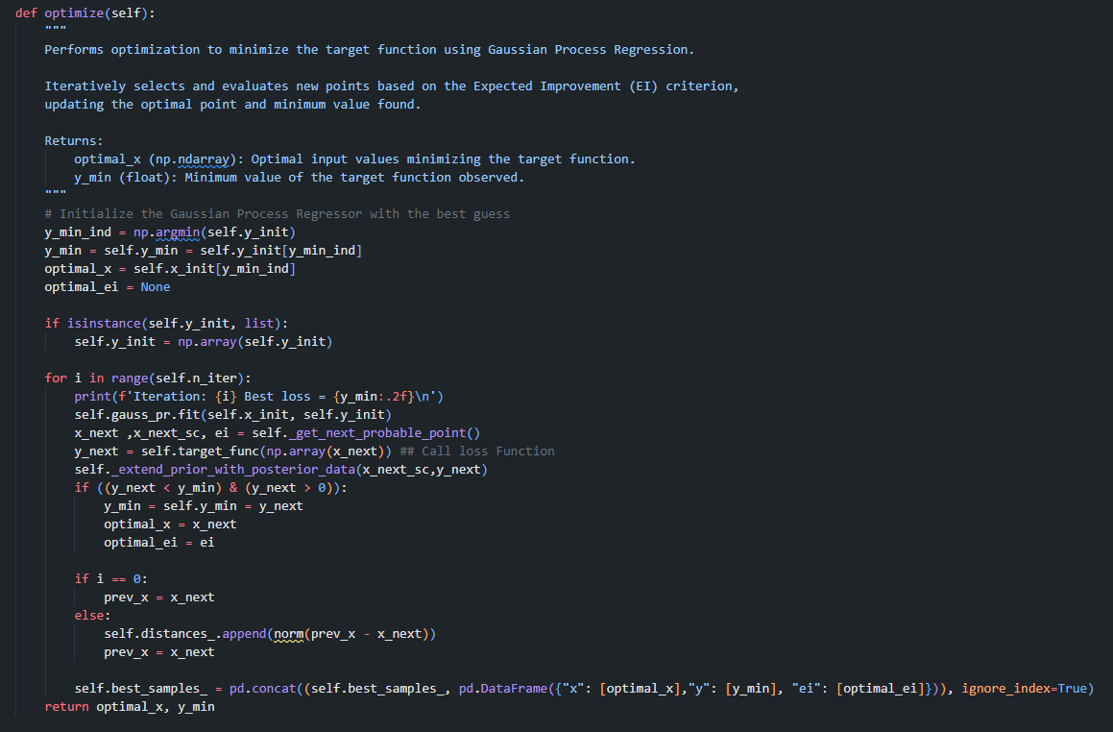
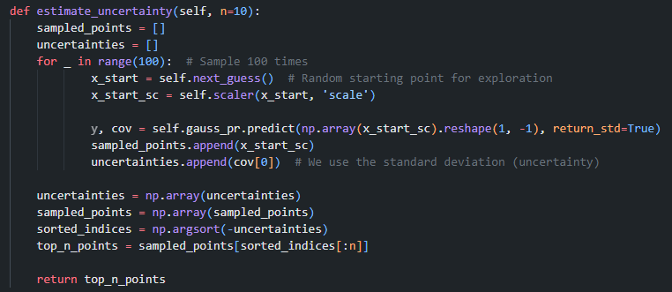
Solution Method Neccessary details 2
Class bopt: Optimise Function A breakdwon of the function, Next solution computations OBJ Function Frequency loss Mass loss Normalisation Weighting Monitoring
The bayesian optimisation function, or at least in part. Through this function we can actively learn through:
Gaussian Process – As already described we fit and sample the GP not only as a surrogate but also as a way of understanding uncertainty in our exploration.
Kernel - arguably the most crucial hyperparameter/s since without it and specially with an EI acq function learning is close to impossible..
Minimiser – GP’s are good but a gradient descent method allows us to validate regions we have been thrown into in our bayesian optimiser solution space.
Much more: There are many choices in the optimiser architecture type of GP & its likelihood, acq function accumulation fitting strategies and more..

Slide 13
Solution Method END
Unfortunately due to different reasons we cannot provide further details on the behaviour of out algorithm but we faced many challenges when writing our own algorithm:
Kernel length scale bounds – Reaching length scale limits and not capturing the covariance sufficiently.
Guassian Process – Fixed covariance and of much greater magnitude than target.
Implementation of uncertainty based search method – Increased our reliance on the GP’s ability to understand the data.
Nevertheless, we went for another solution with the BoTorch module

Slide 14
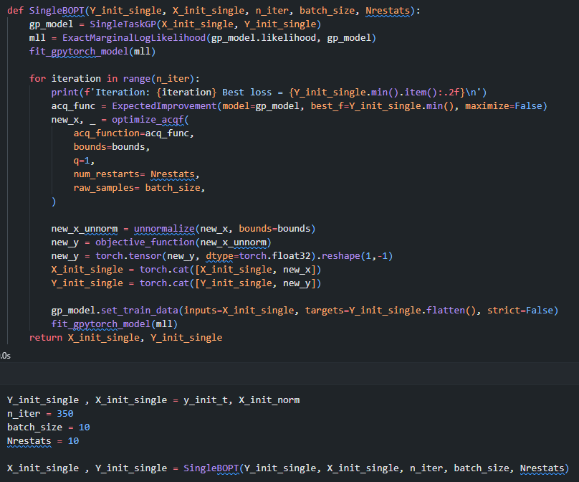
Solution Method BoTorch
Easy to implement
Same architecture and components
Less issues and less flexibility. Many BoTorch features will soon be deprecated.
Efficient if well implemented and works with, with more flexible multitask GP’s. This would allow the separation of the loss function into a constraint function and loss function.
Torch implementation allows for
Monte Carlo acquisition can be particulatly useful with loss functions such as in this project.
BoTorch: Bayesian optimiser A breakdwon of the function, Flexible GP's In built optimisation with search sampling Acquisition function alternatives

Slide 15
Results
CEGM2003 DSAI: TRUSS 1

Slide 16
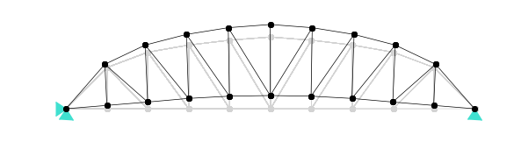
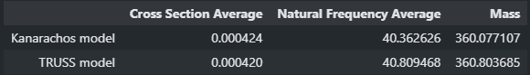
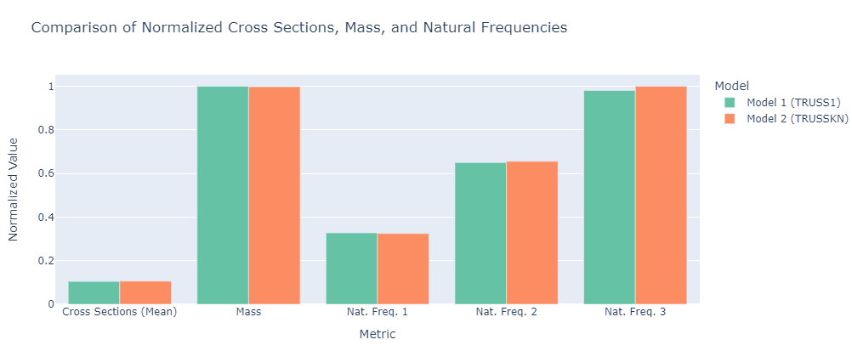
Karnachos TRUSS
Results Did we beat karnachos?
You tell me
350 Iterations
Truss execcution time 33 minutes
Karnachos execution time 20 minutes

Slide 17
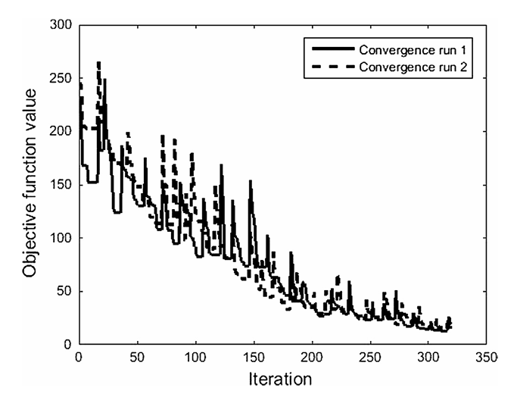
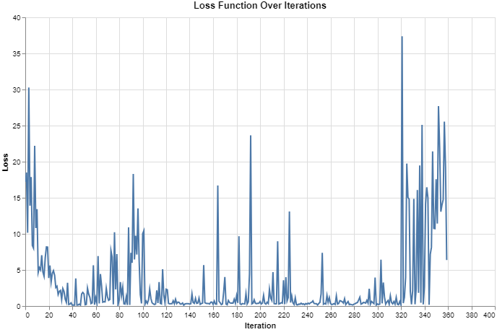
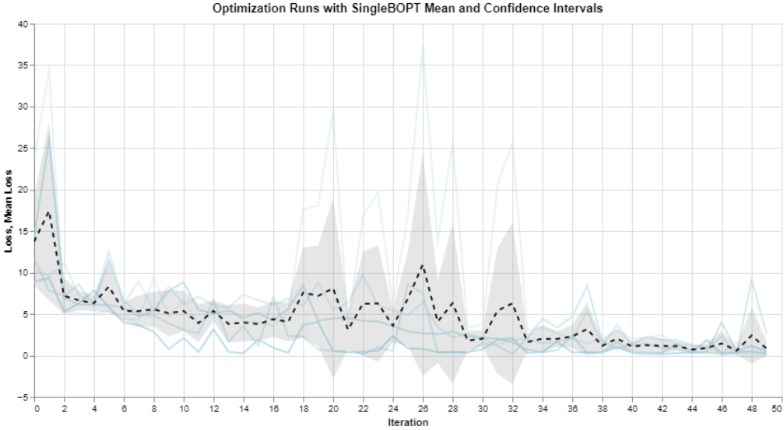
Results Convergence Behaviour
The following two images present optimisation behaviour where in our model we ran it 5 times 50 iterations and measured the variance and mean in the optimisation paths. From it we can observe,
Very similar solution gradients with TRUSS plateaing faster
Karnachos and TRUSS both seem to optimise with similar capabilities

Slide 18
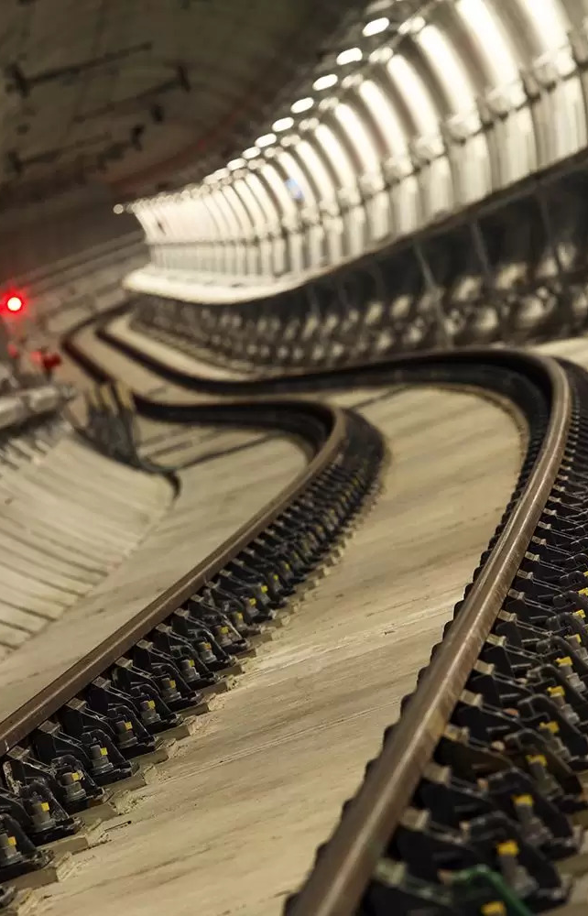
Conclusions and Next steps
We have demonstrated that bayesian optimisation is a powerful approach to optimisation and is competitive against other state of the art alternatives.
Karnachos and TRUSS both seem to converge similarly although Karnachos stronger optimisation helps reach the solution faster.
Moving forward implementation of new acquisition functions may prove very benefitial.
Implementation of multitasks GPs can also be very benefitial in this problem.
Implement dynamic constraints into the optimiser.

